Slide 1

AFK Engine
by Pack Mules
Domenic Pullar-Khan
Kenneth Mak

Slide 2
AFK Engine
A 2D engine
Focuses mostly on collision and physics
Rectangle & Circle shapes
GameObject hierarchy similar to Unity
Transforms
Rigidbody

Slide 3
Golf Greens
A Demo of our engine with a mini-golf game
Currently a 2-Player game

Slide 4
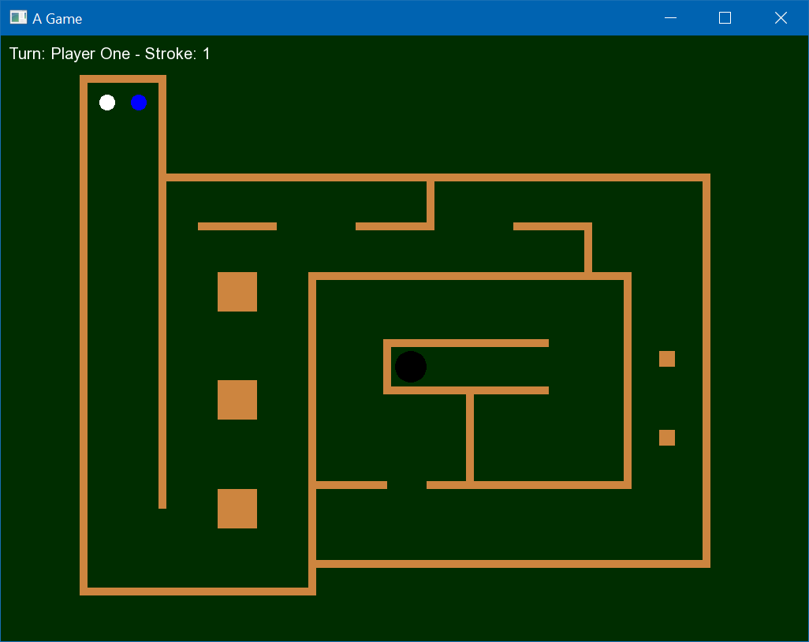

Slide 5
Golf Greens
Balls can be hit while in motion
Balls will collide with other balls

Slide 6
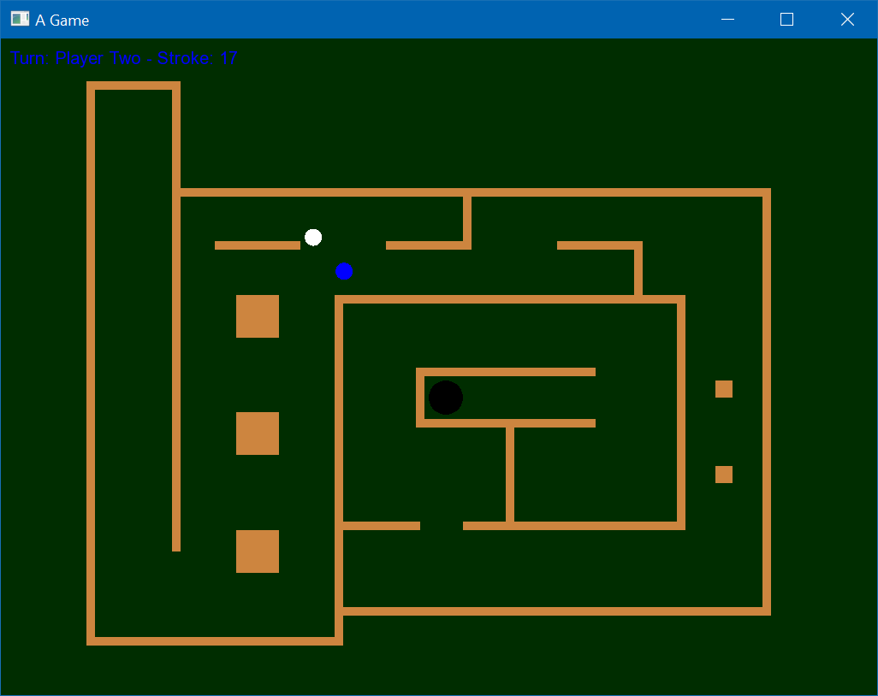

Slide 7
What else can this engine be used for?
Anything with simple collisions with shapes of rectangles or circles
Most simple 2D Games
Pong
Brick Breaker
Pool
Possibility of platformers

